Slide 1
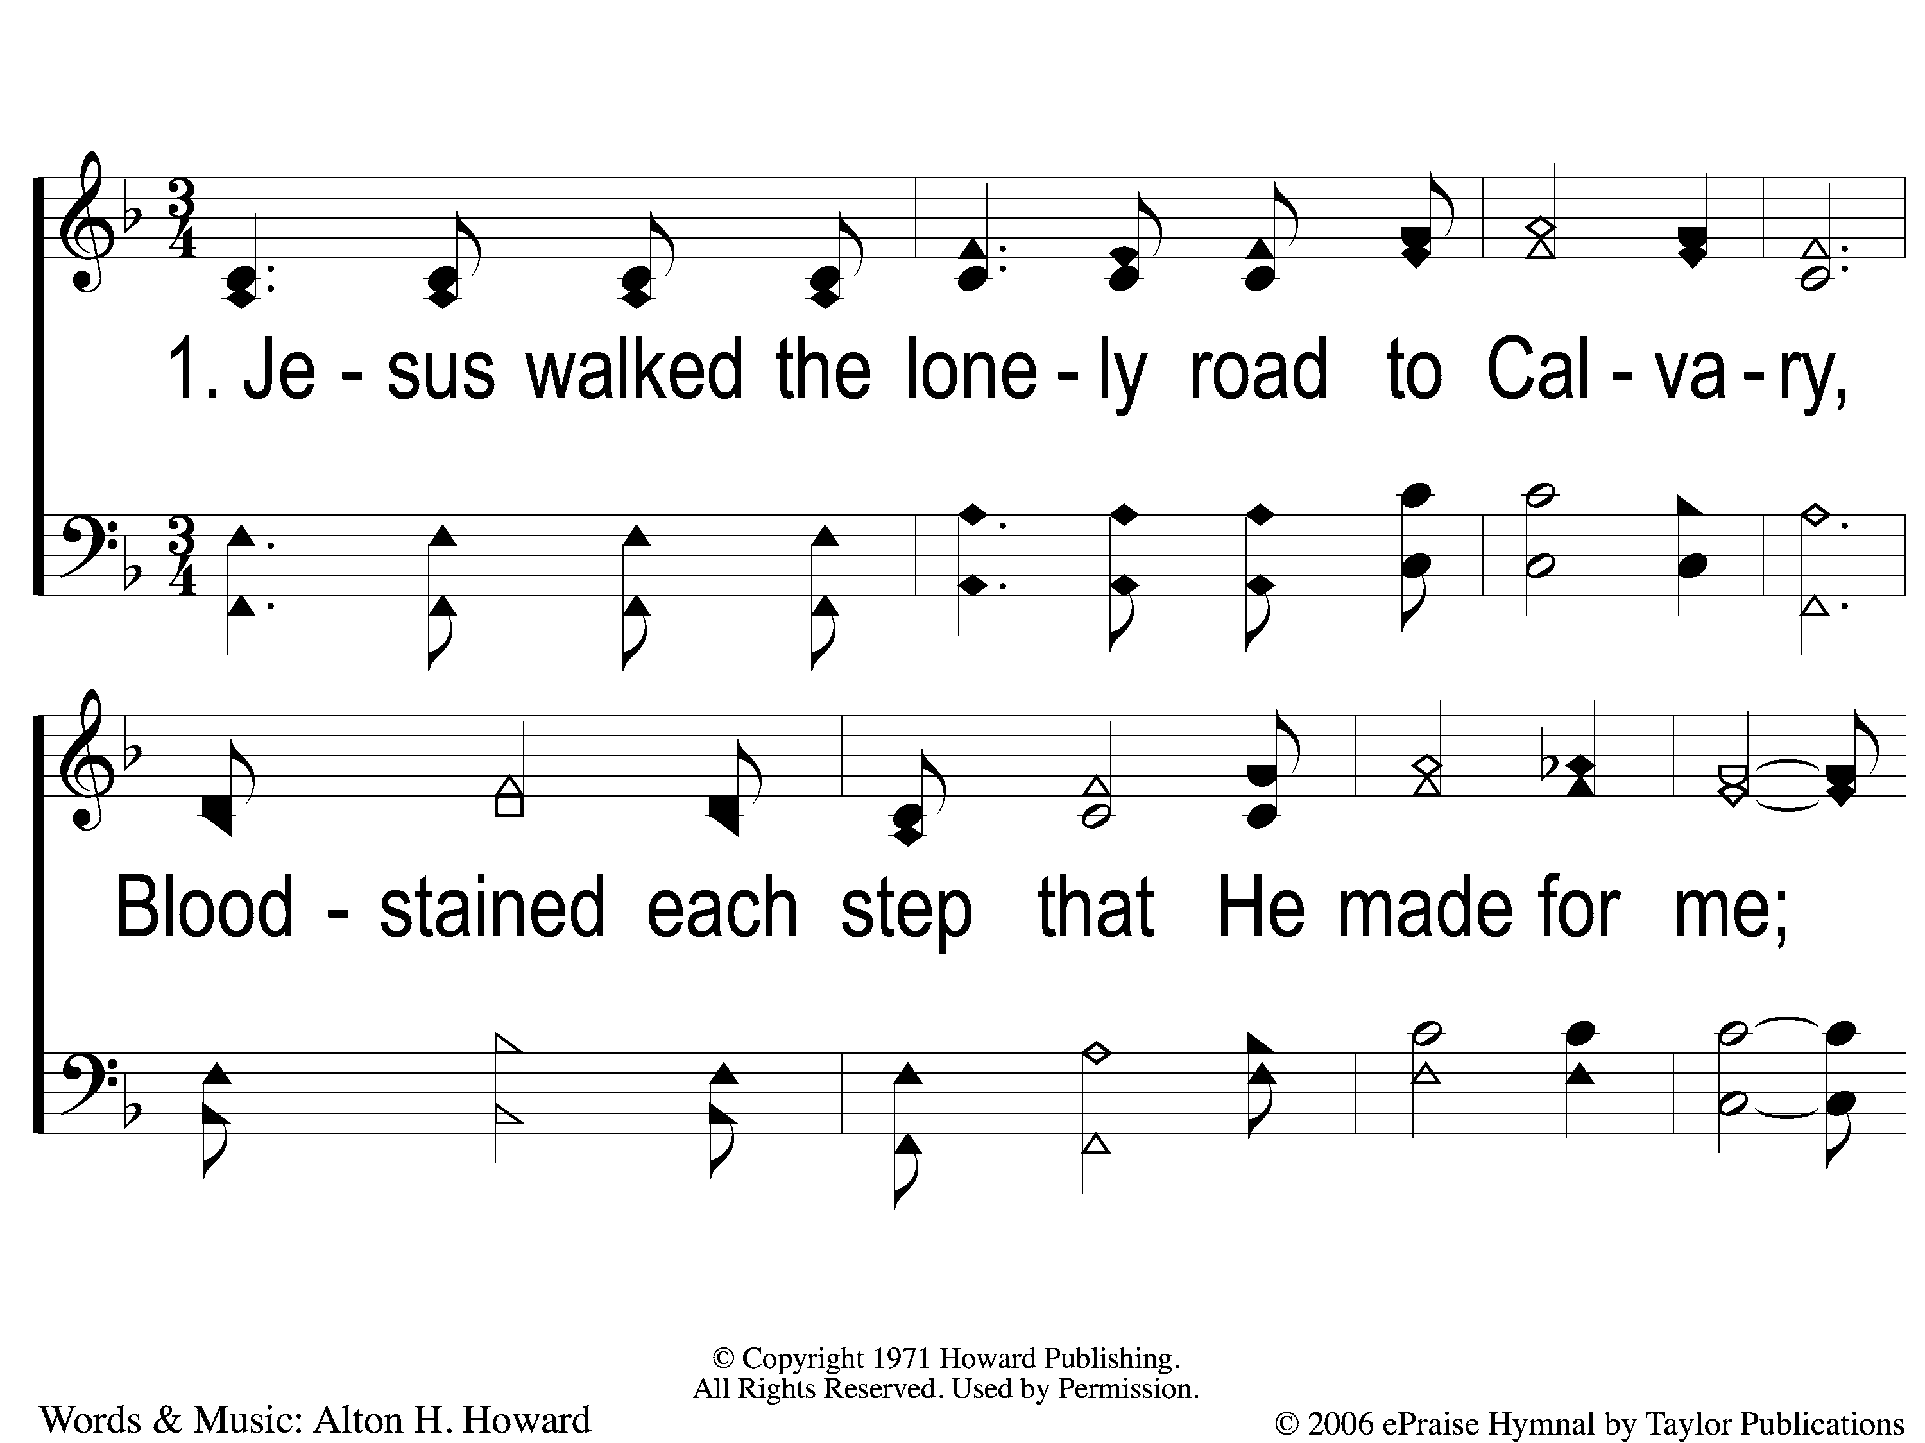
1-1 He Cares For Me
He Cares For Me
154

Slide 2
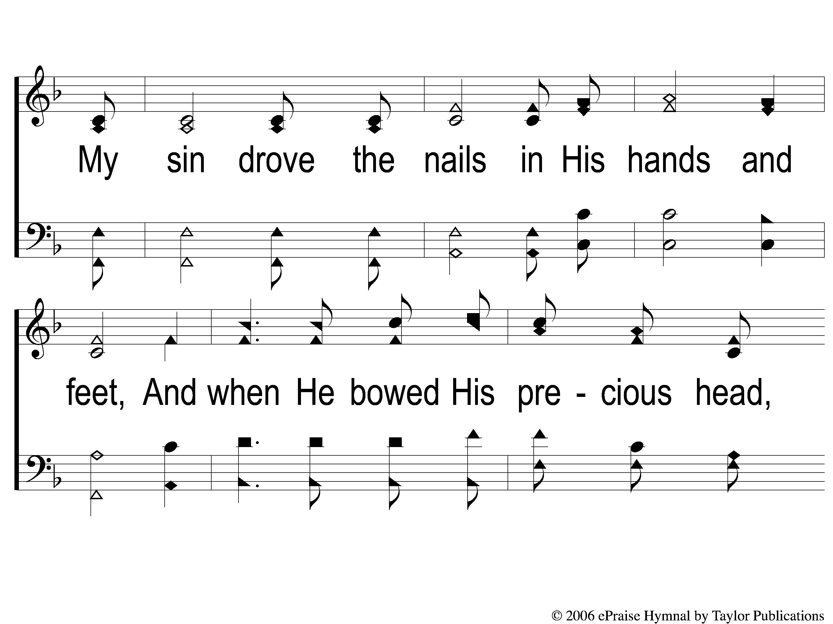
1-2 He Cares For Me
He Cares For Me
154

Slide 3
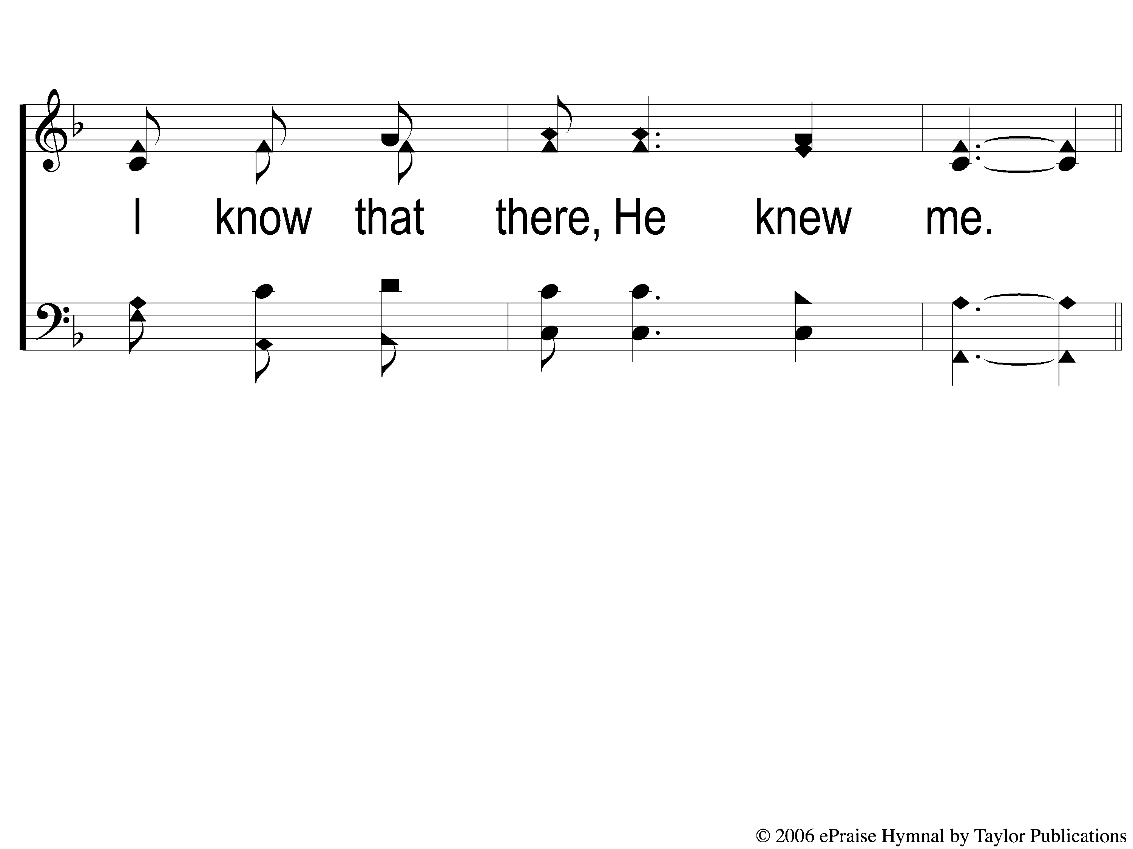
1-3 He Cares For Me
He Cares For Me
154

Slide 4
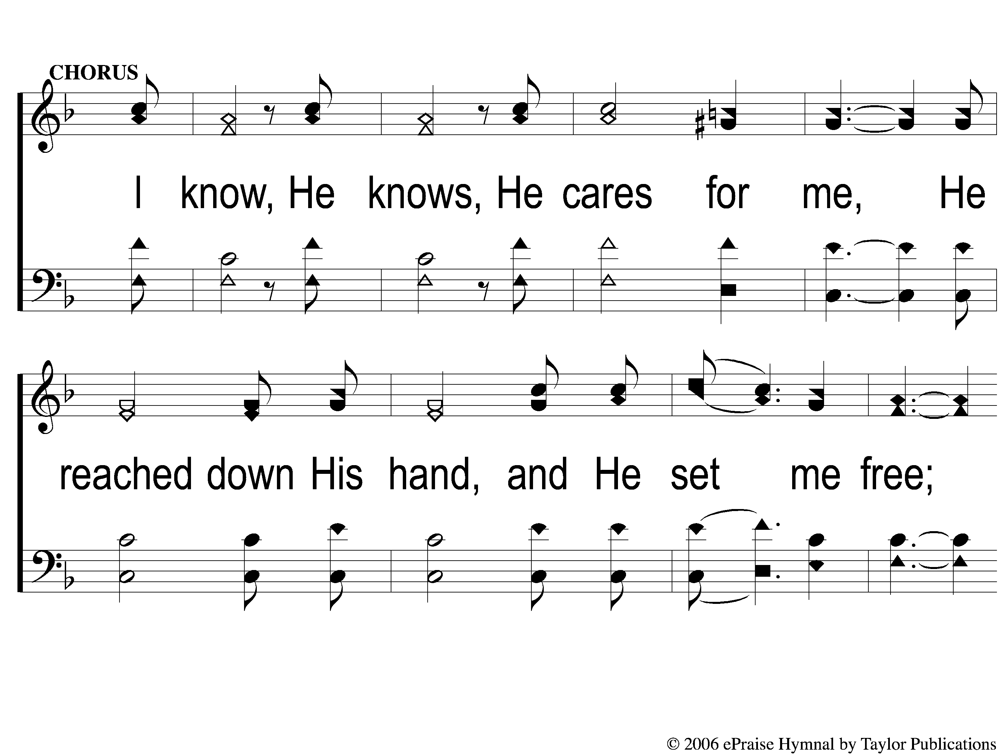
C-1 He Cares For Me
He Cares For Me
154

Slide 5
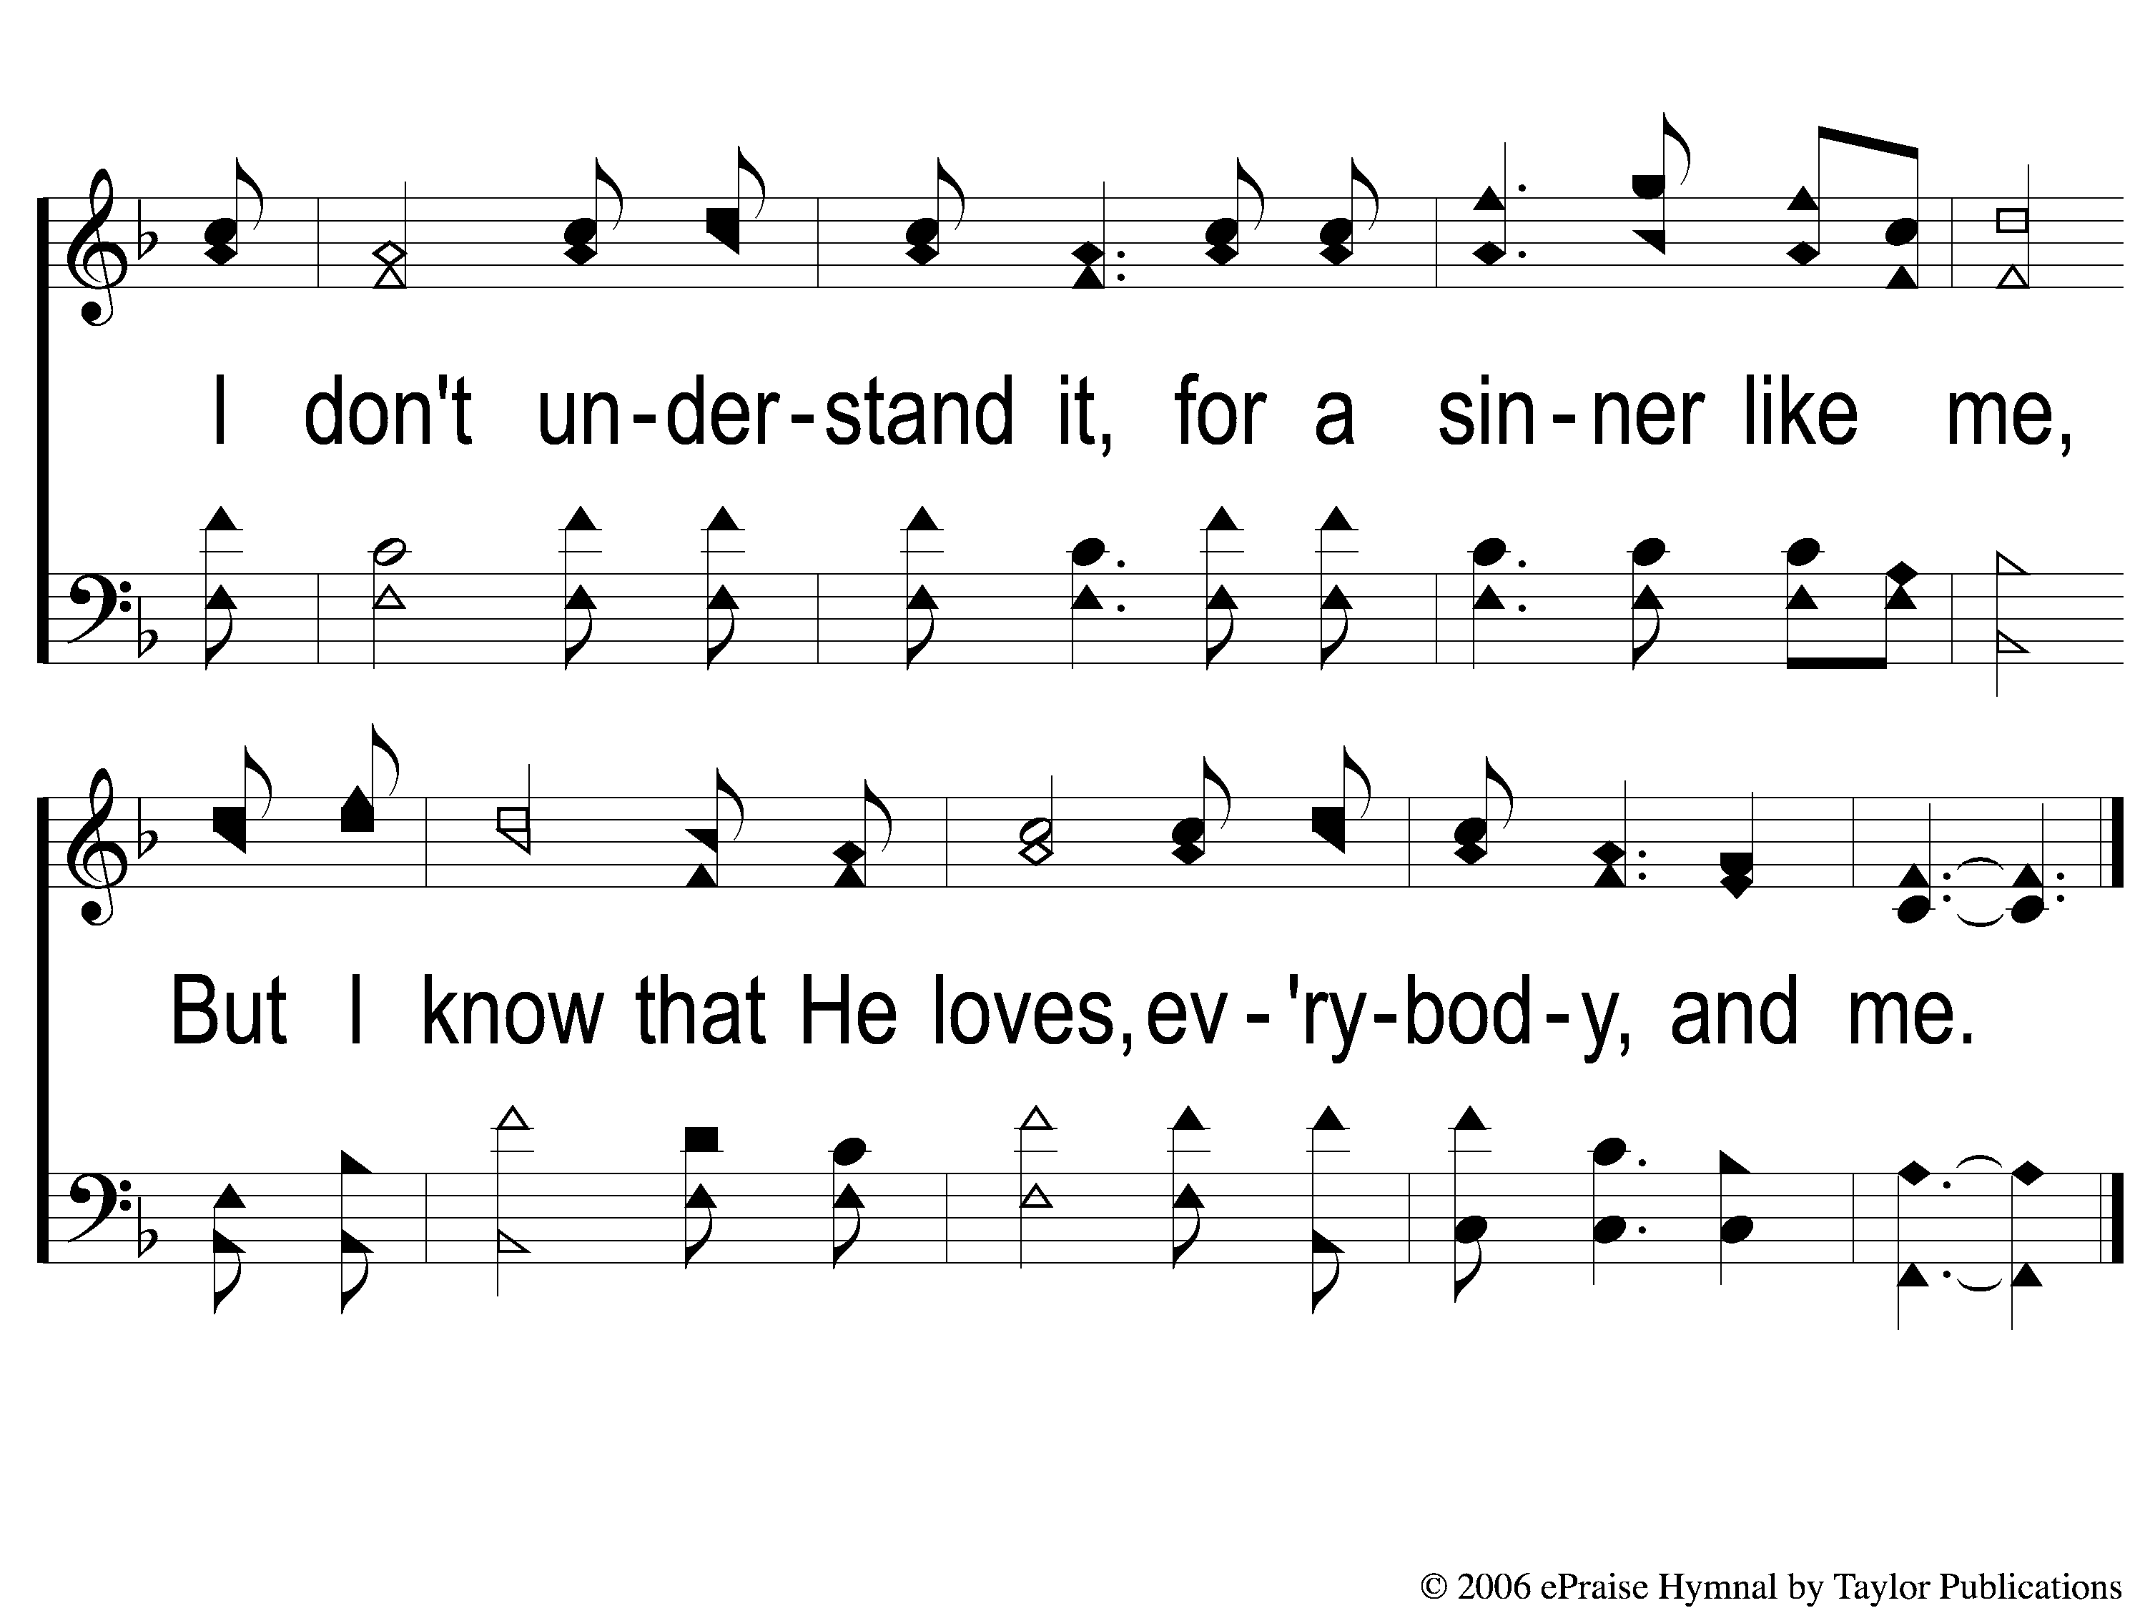
C-2 He Cares For Me
He Cares For Me
154

Slide 6
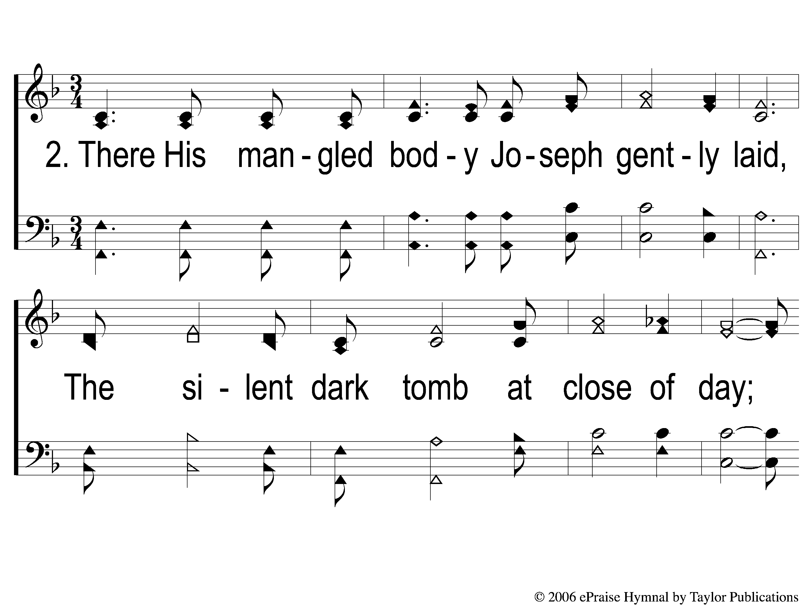
2-1 He Cares For Me
He Cares For Me
154

Slide 7
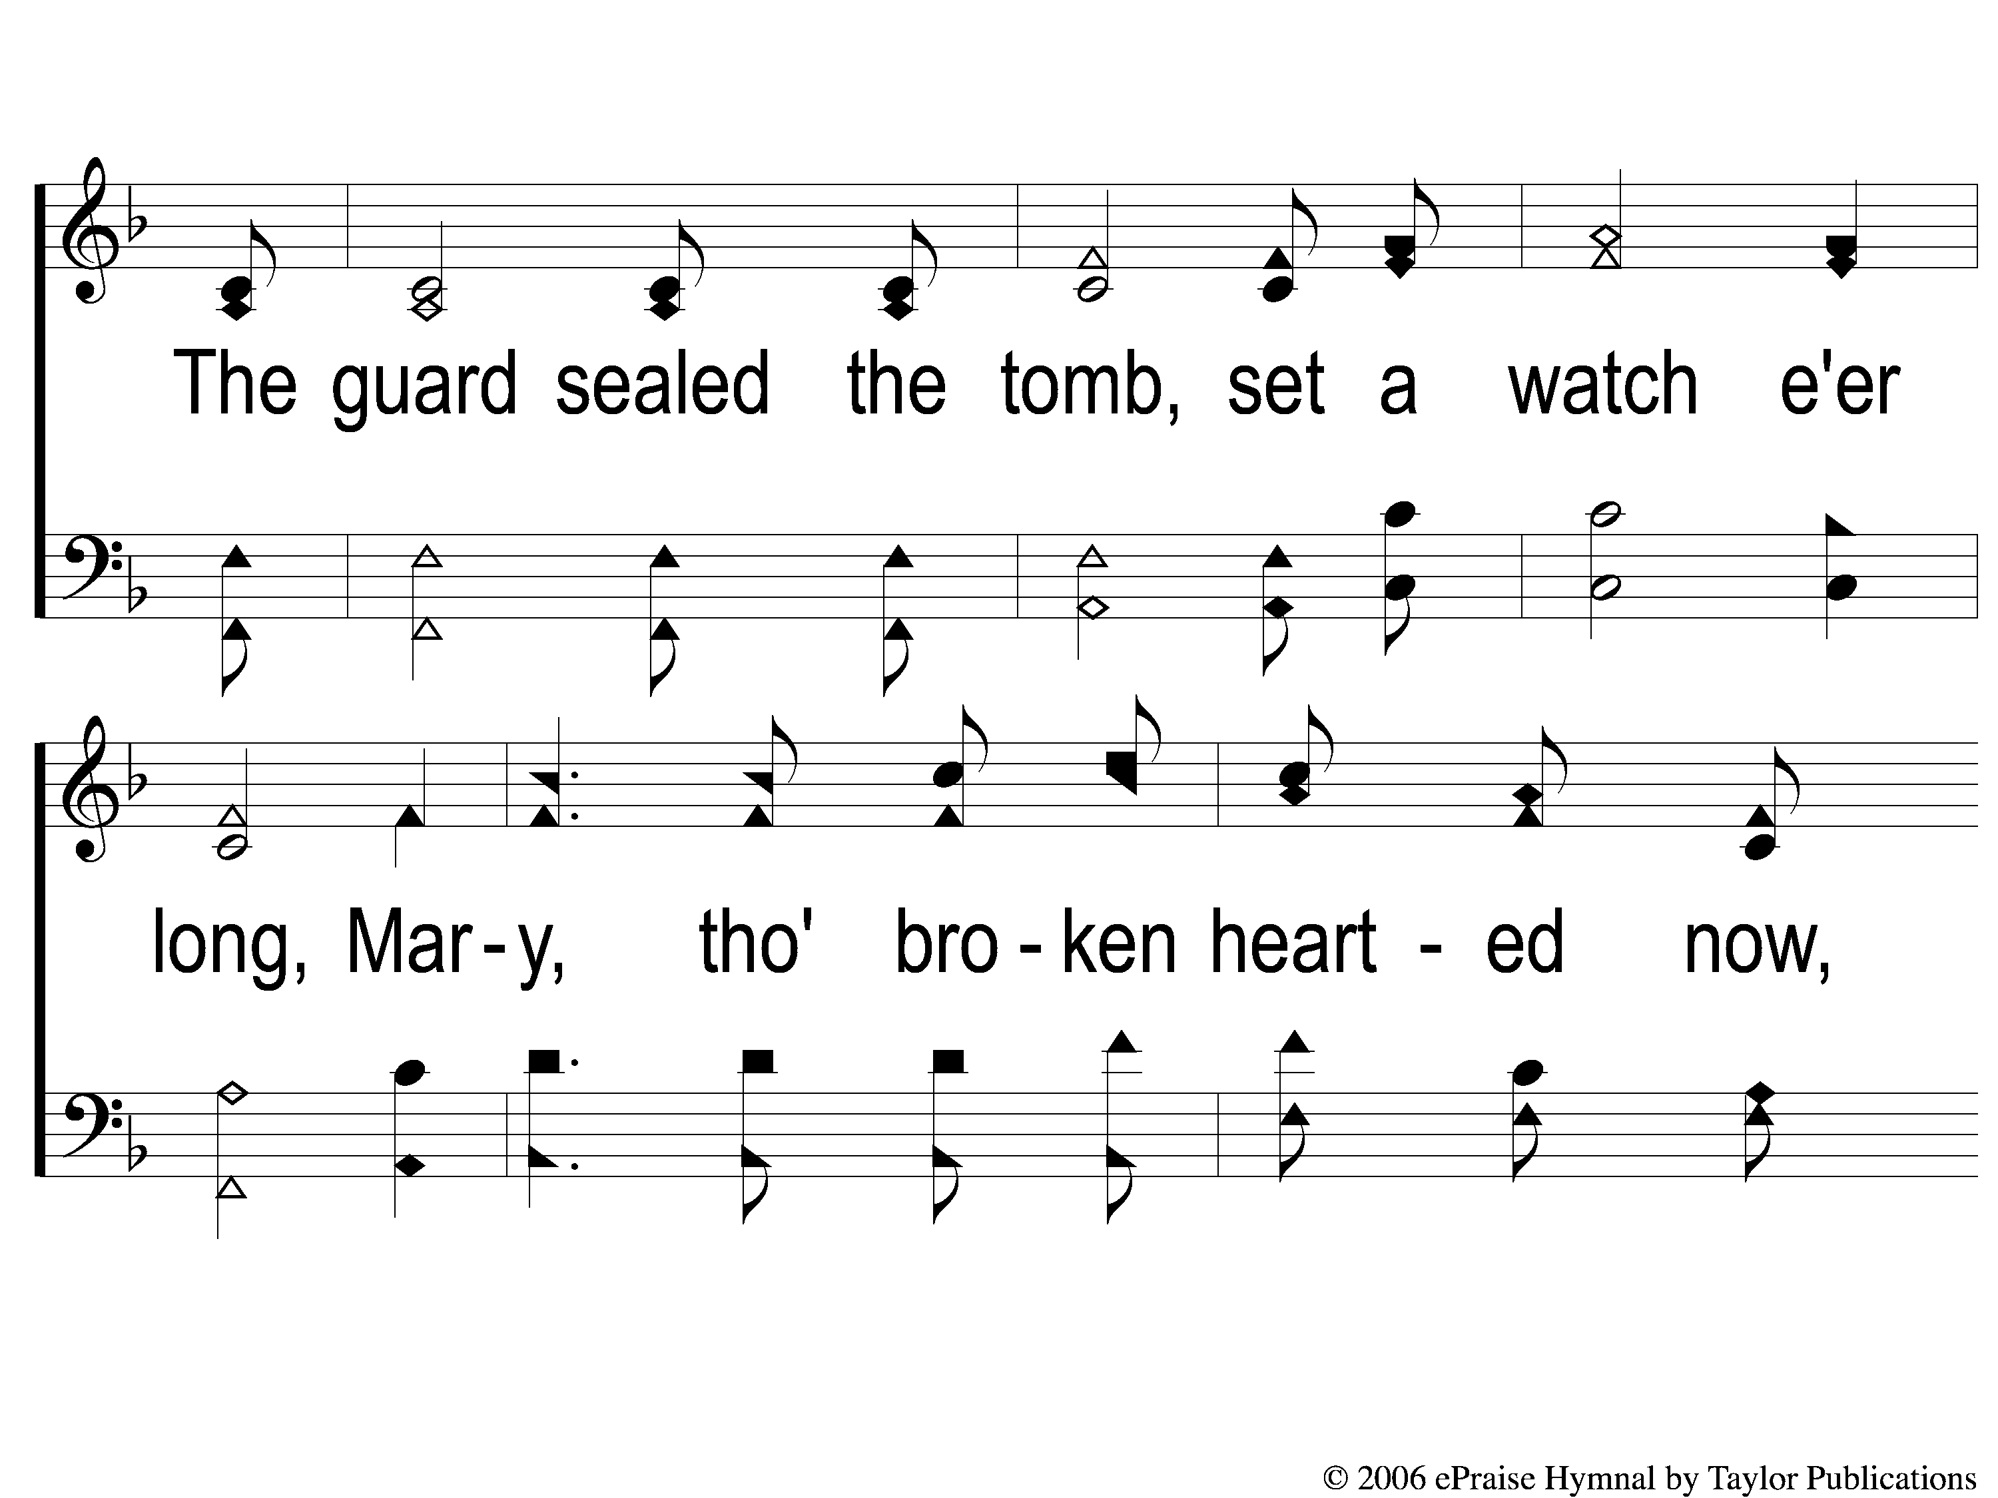
2-2 He Cares For Me
He Cares For Me
154

Slide 8
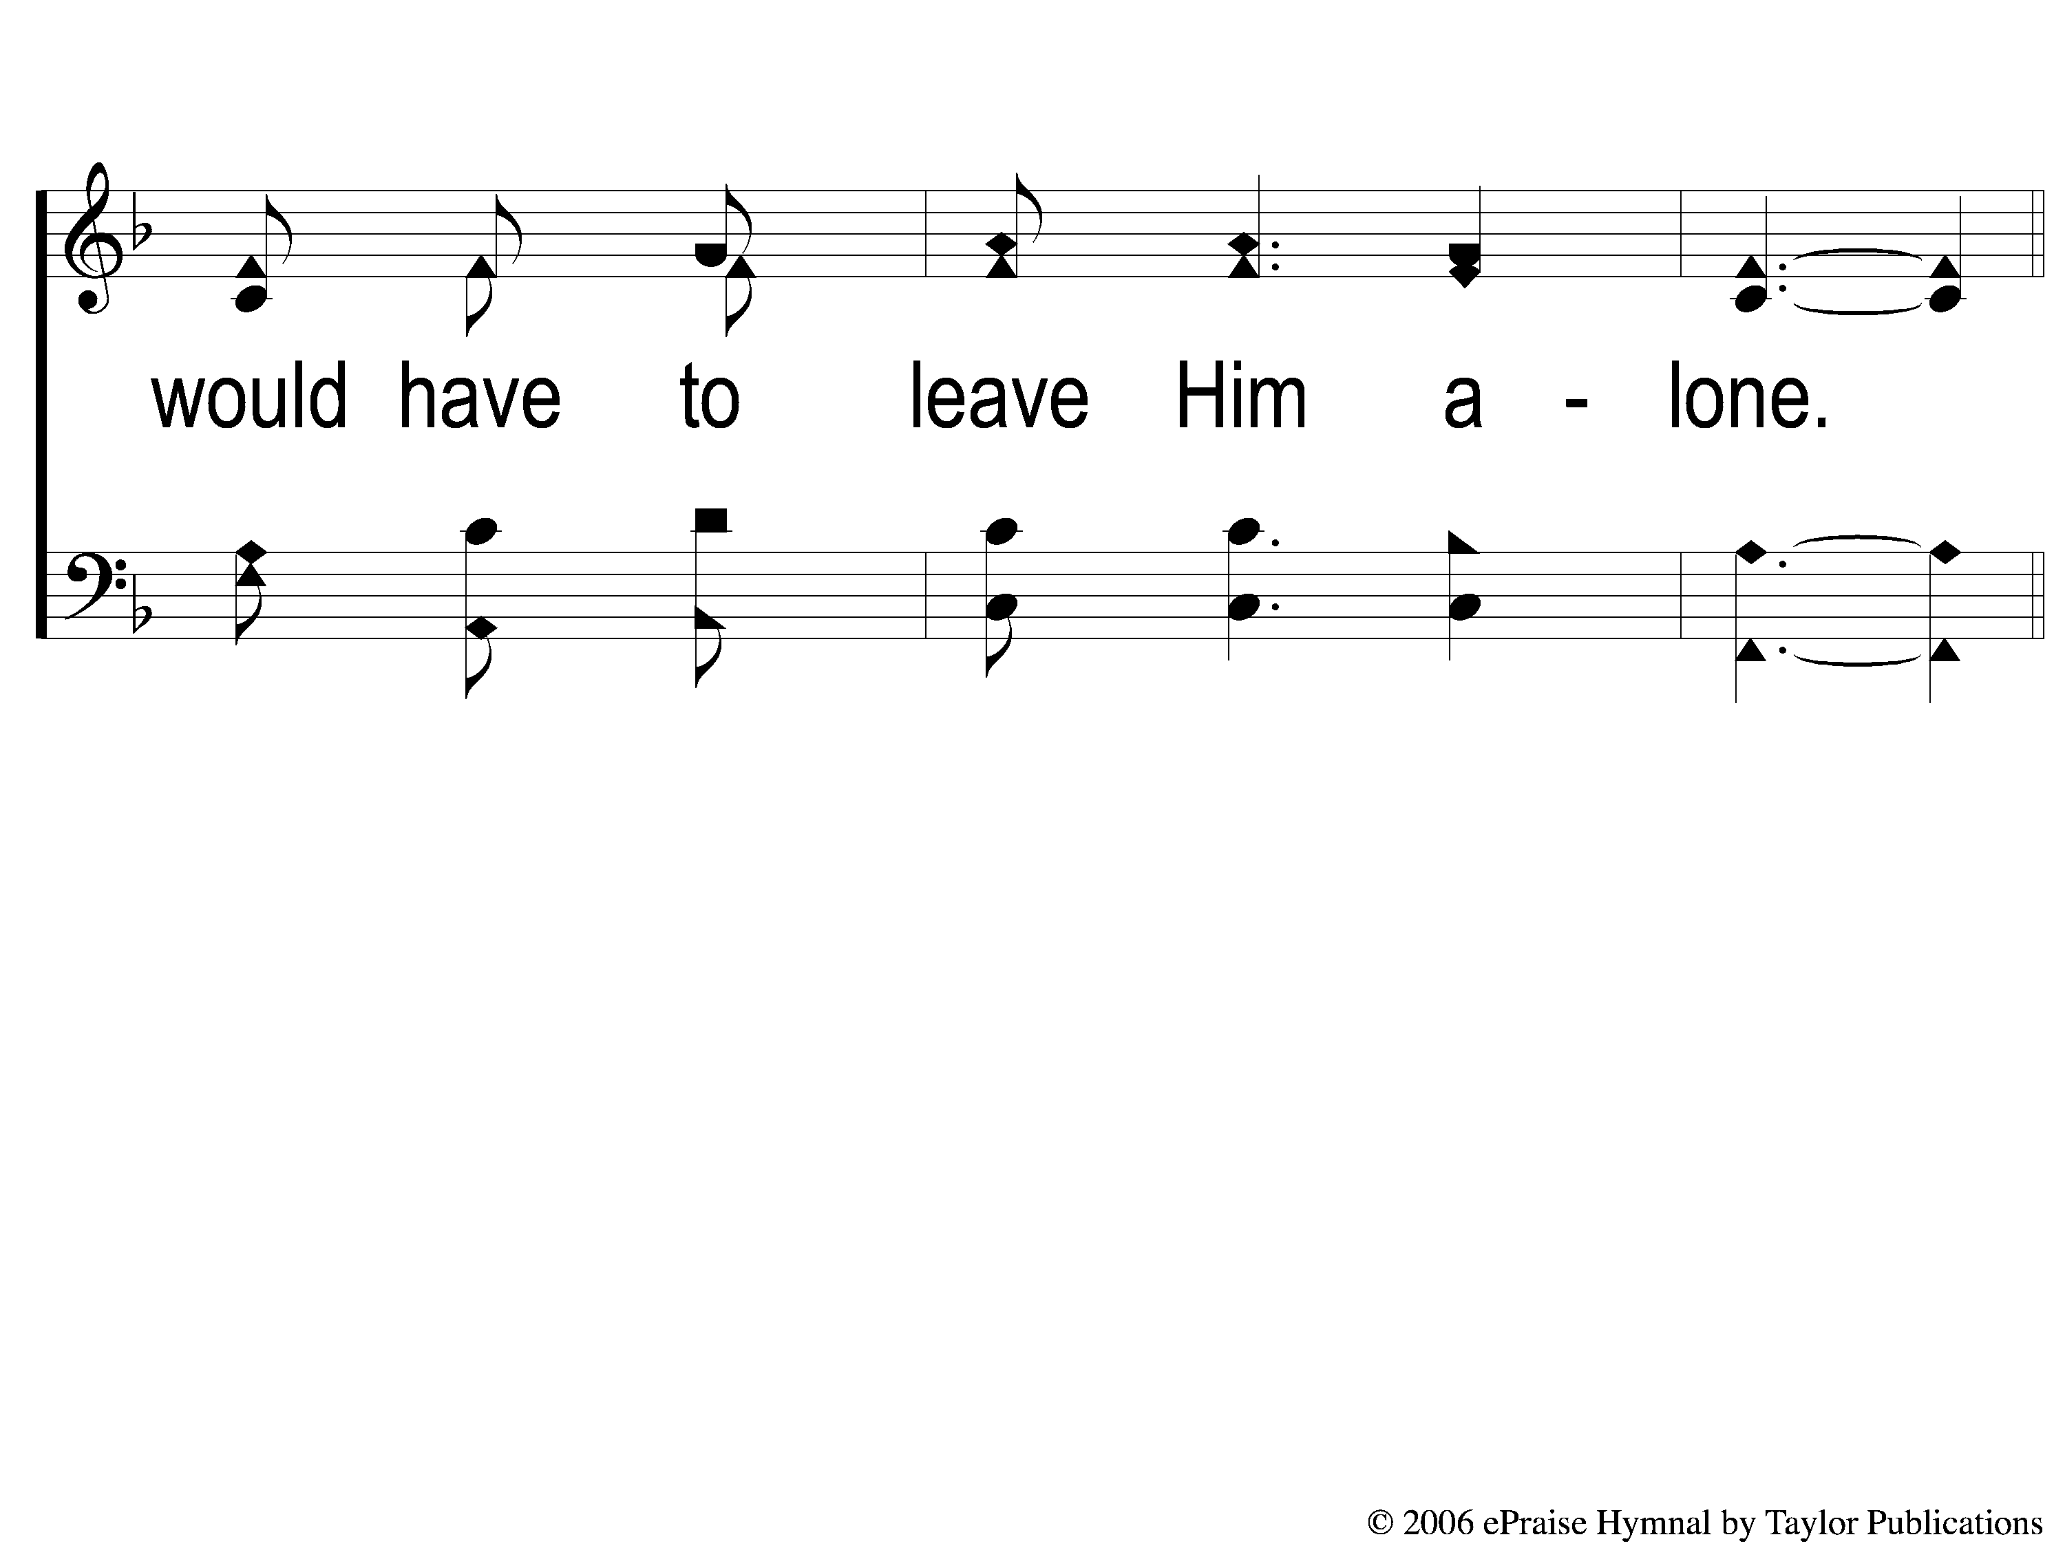
2-3 He Cares For Me
He Cares For Me
154

Slide 9
C-1 He Cares For Me
He Cares For Me
154

Slide 10
C-2 He Cares For Me
He Cares For Me
154

Slide 11
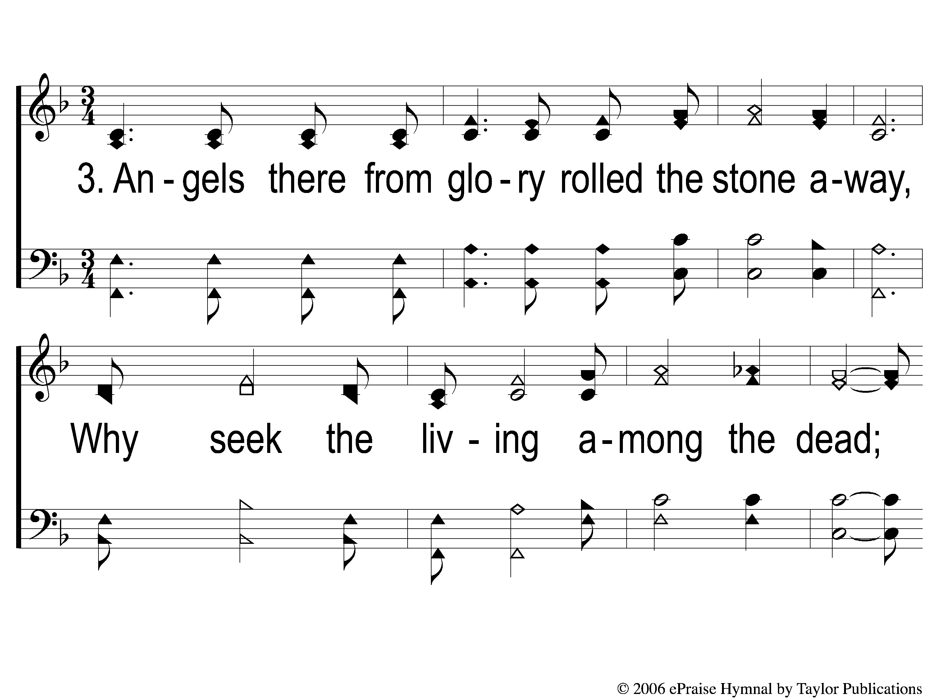
3-1 He Cares For Me
He Cares For Me
154

Slide 12
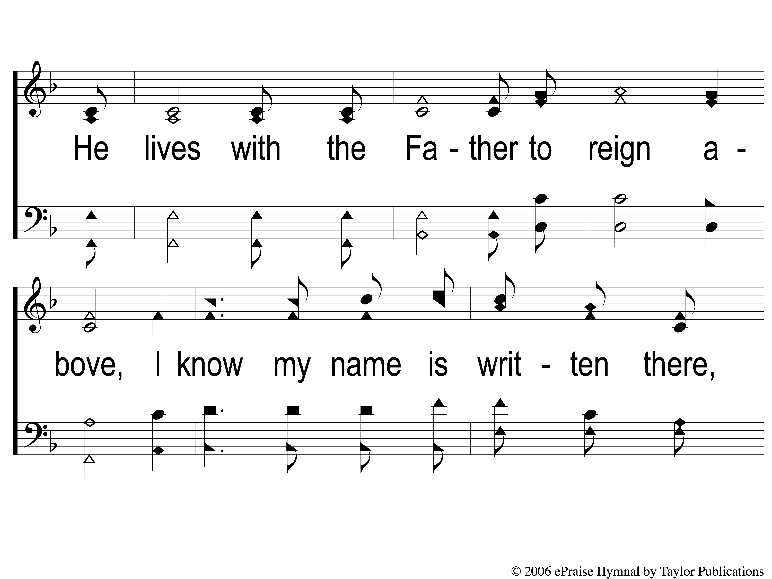
3-2 He Cares For Me
He Cares For Me
154

Slide 13
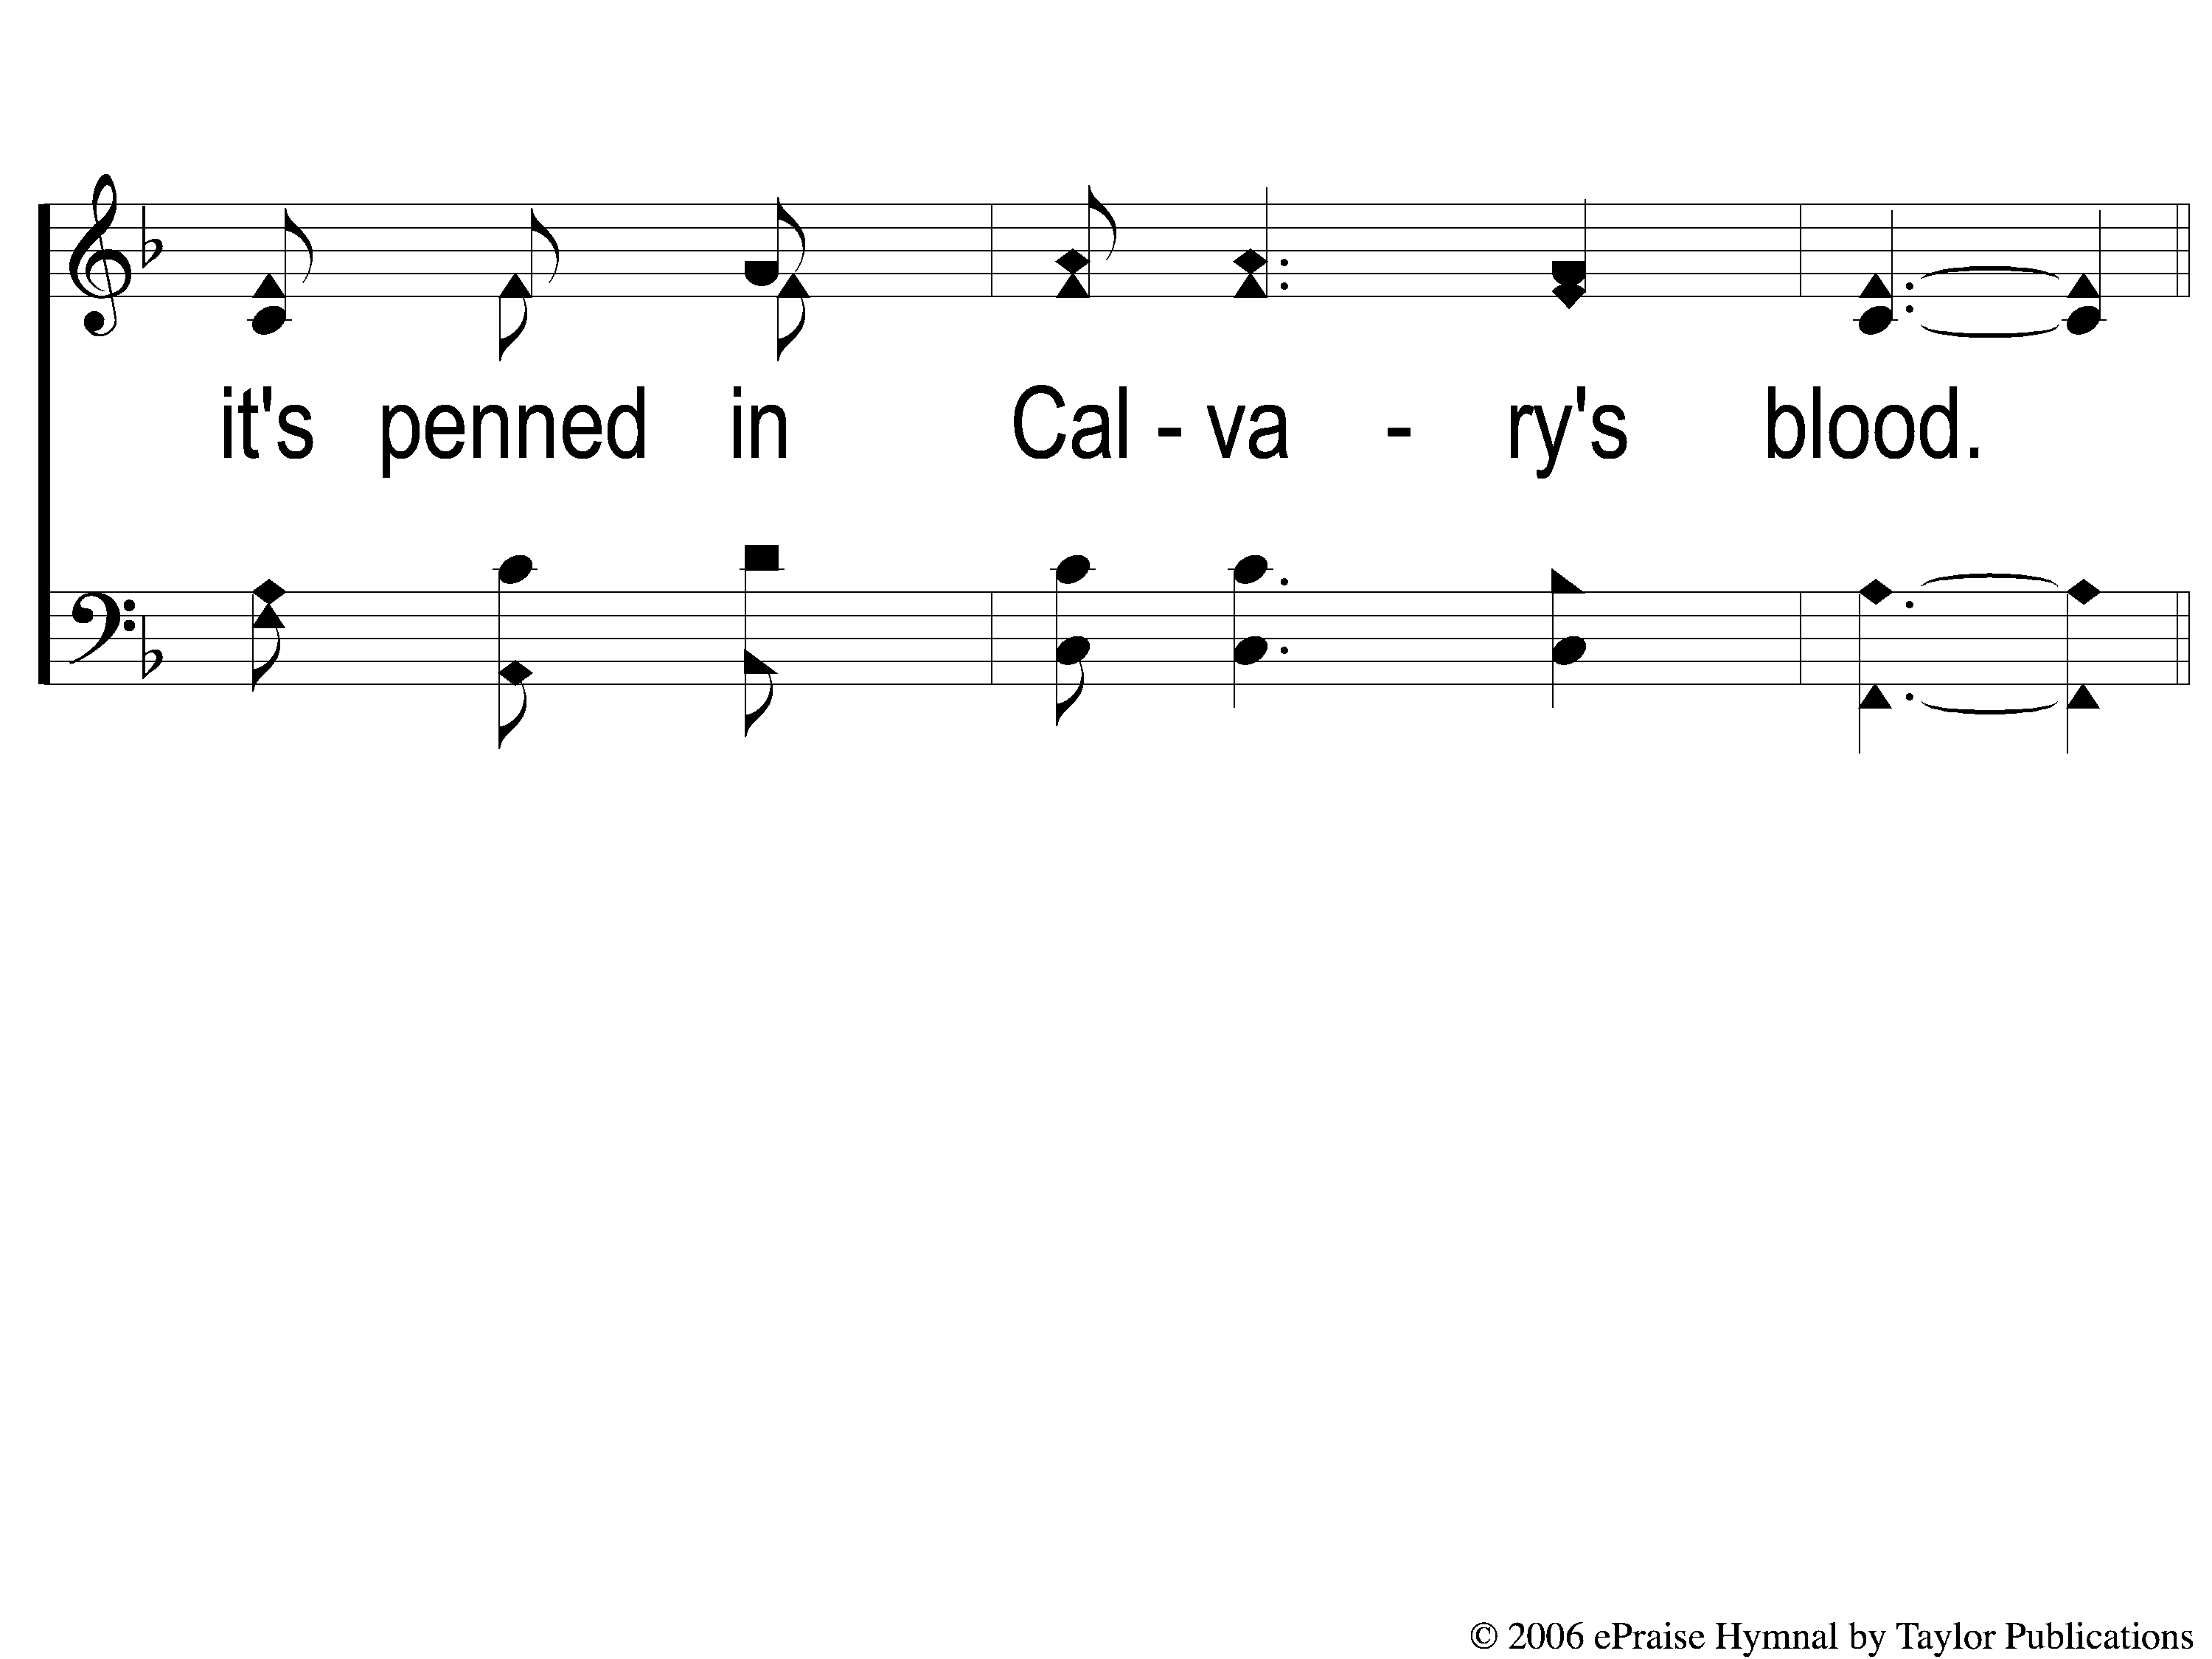
3-3 He Cares For Me
He Cares For Me
154

Slide 14
C-1 He Cares For Me
He Cares For Me
154

Slide 15
C-2 He Cares For Me
He Cares For Me
154

